Slide 1
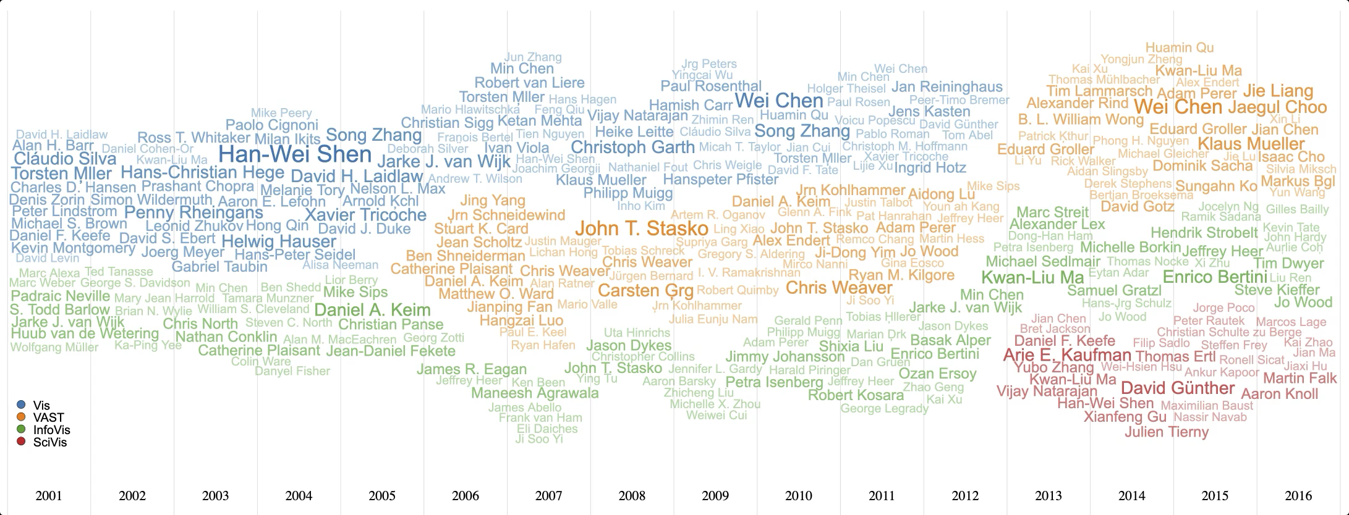
WordStream: Interactive Visualization for Topic Evolution
Tommy Dang, Huyen Nguyen, Vung Pham
Texas Tech University, Lubbock, USA

Slide 2
Introduction
WordCloud
StreamGraph

Slide 3
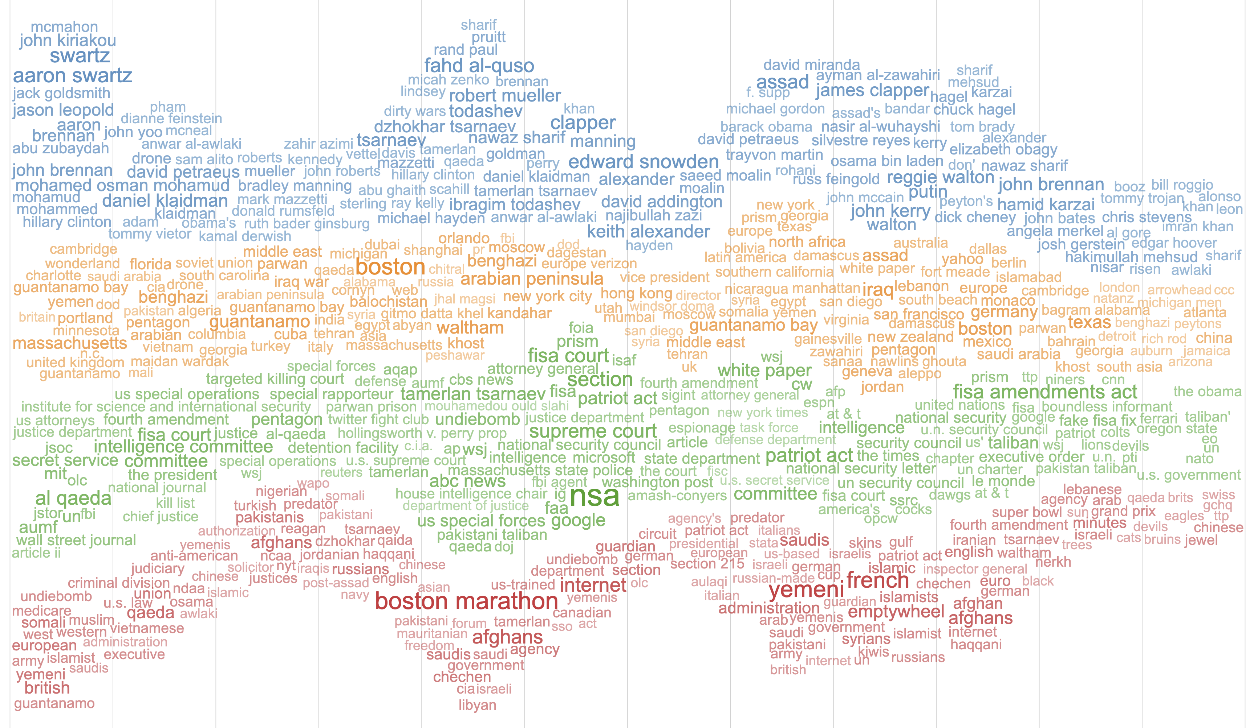
Introduction
Jan | Feb | Mar | Apr | May | Jun | Jul | Aug | Sep | Oct | Nov | Dec
WordStream
person
location
organization
miscellaneous

Slide 4
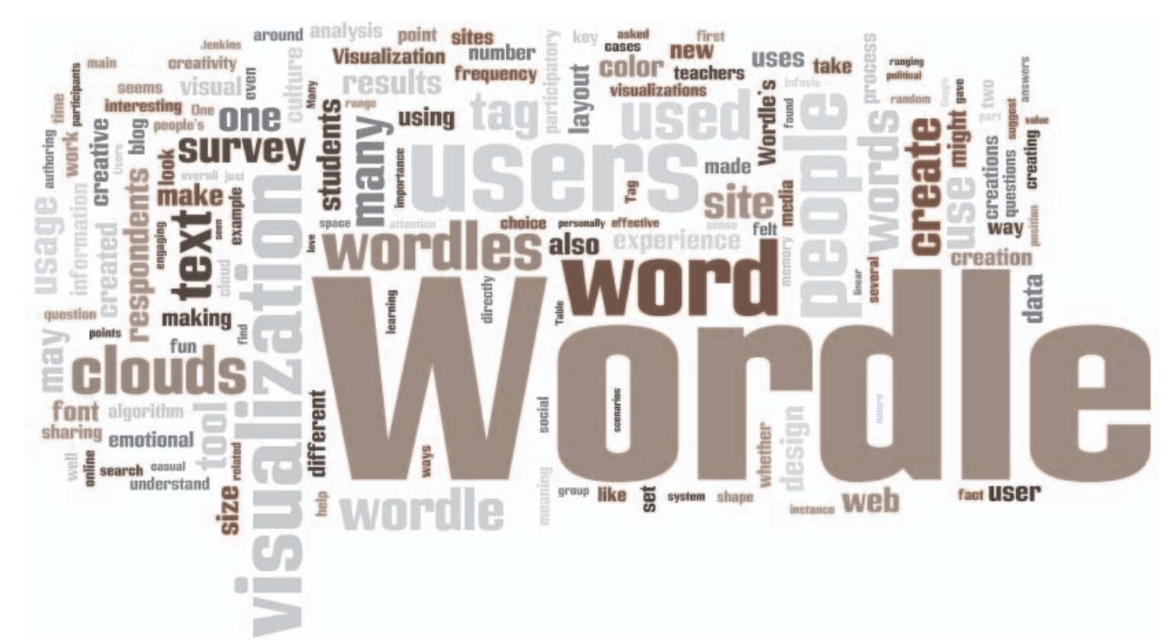
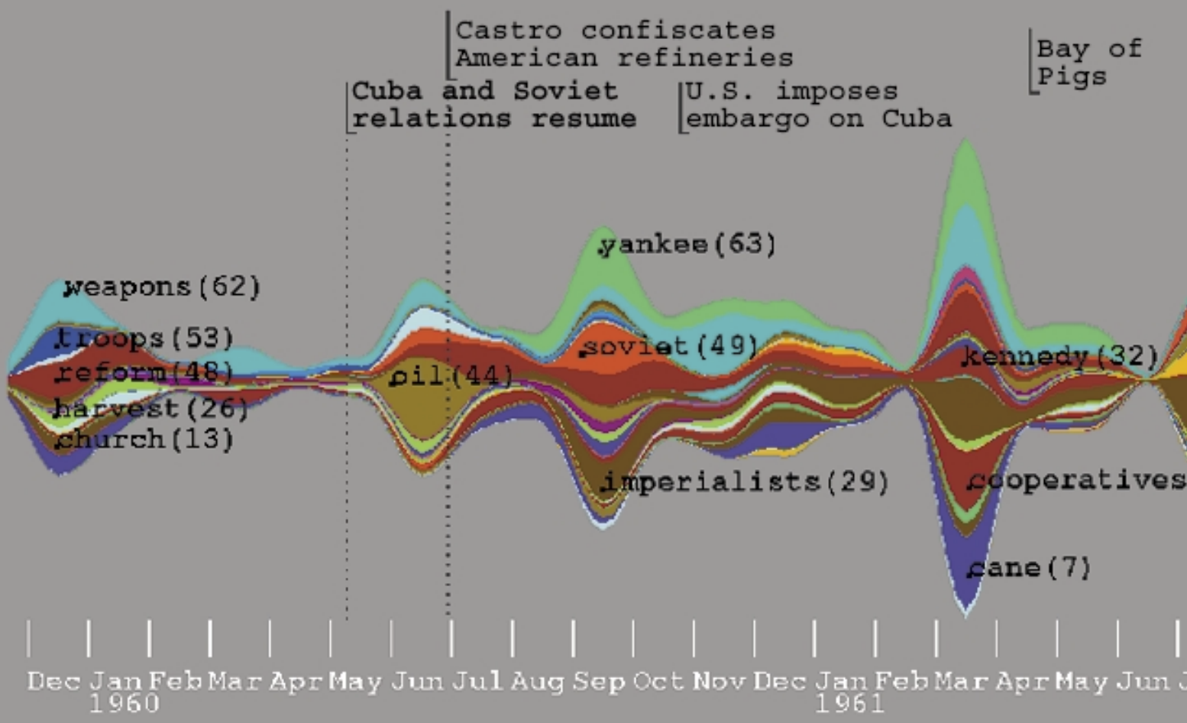

Related Work
Word cloud models
Time Series Visualizations
Wordle [1]
Theme-River [3]
Parallel Tag Cloud [2]
Stacked Graph [4]

Slide 5
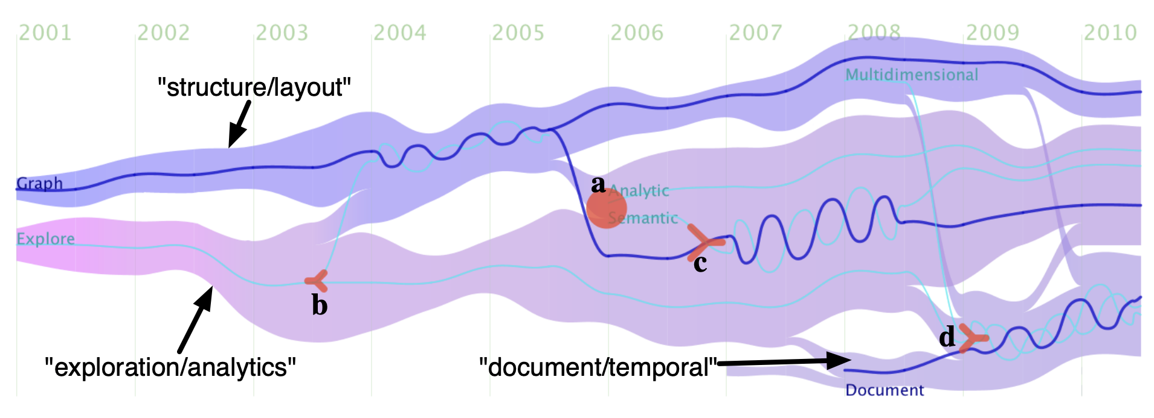
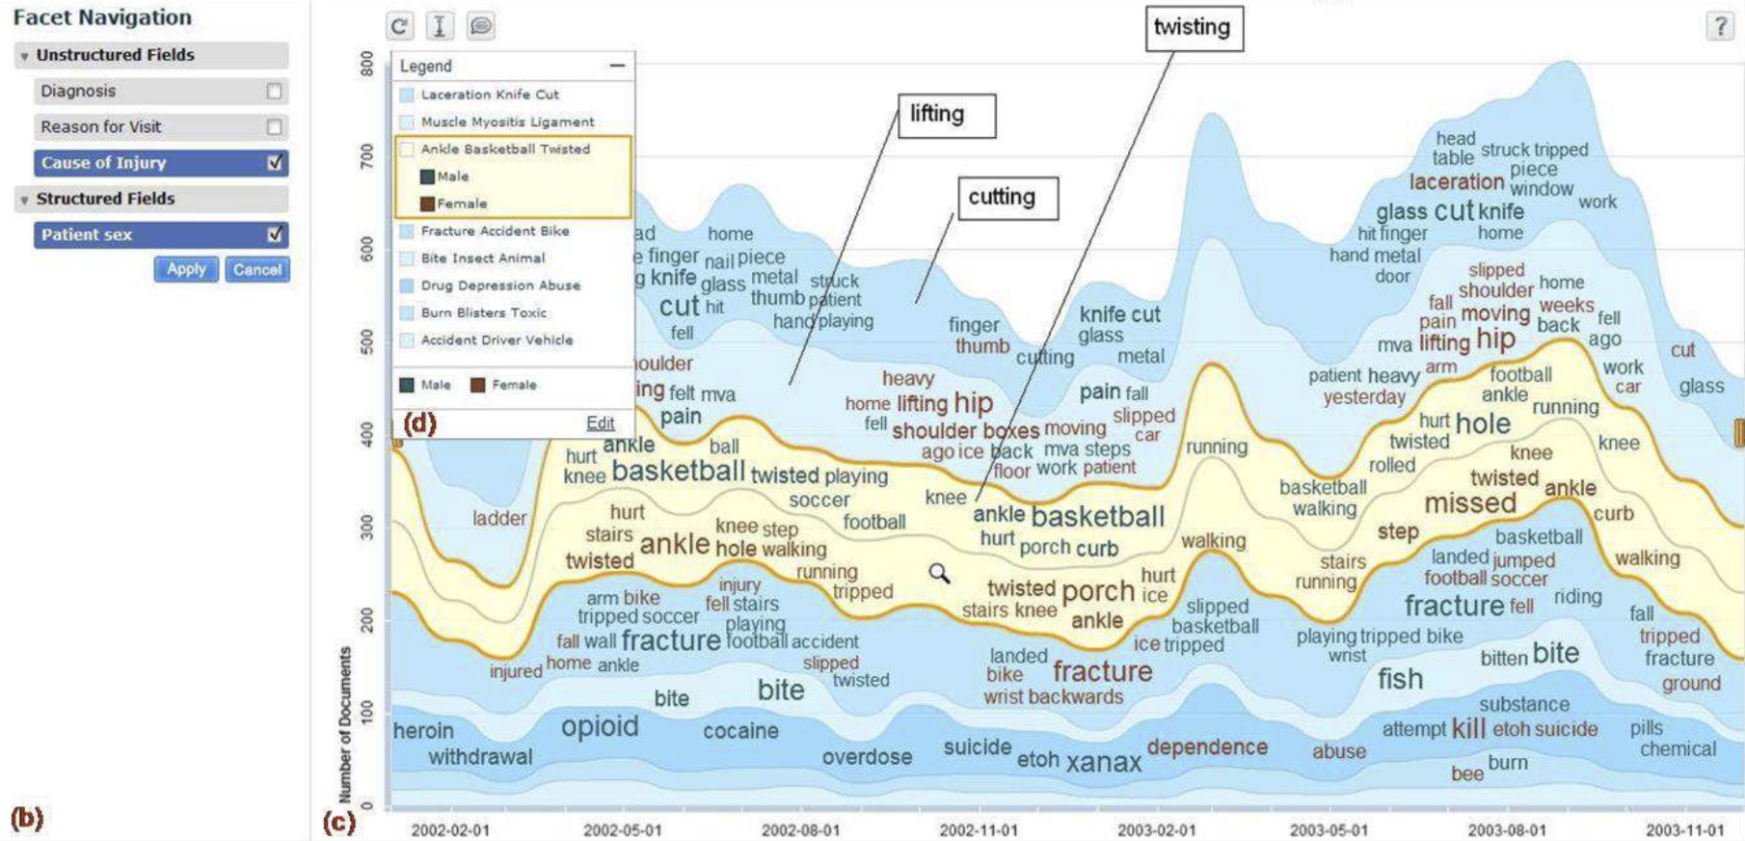
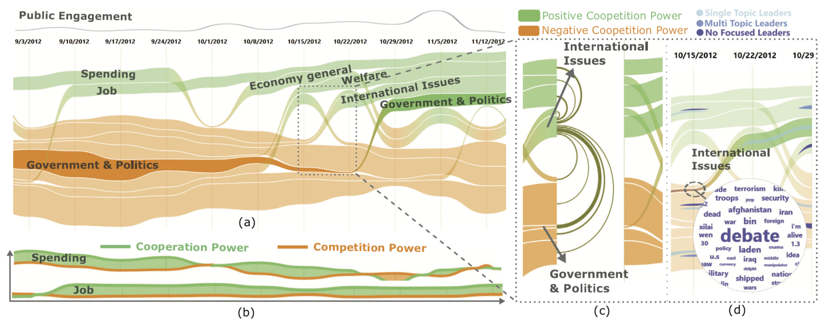
Related Work
Combined models
TextFlow
EvoRiver
TIARA

Slide 6
Architecture
Text sources
Data Cleaning
Tokenization & Segmentation
Classification
Category1
Category2
Category3
Category4
1. Preprocessing
Data
2. Building boxes
Update
Boxes
3. Placing terms
Layers
4. Drawing
Visualization
Evaluation

Slide 7
Architecture
Text sources
1. Preprocessing
Boxes
Data
2. Building boxes
Update
Boxes
3. Placing terms
Layers
4. Drawing
Visualization
Evaluation

Slide 8
Architecture
Text sources
1. Preprocessing
Data
Scanning position
2. Building boxes
Update
Boxes
StreamGraph layer
3. Placing terms
Layers
4. Drawing
Visualization
Evaluation

Slide 9
Architecture
Text sources
1. Preprocessing
Data
2. Building boxes
Update
Boxes
3. Placing terms
Layers
4. Drawing
Visualization
Evaluation

Slide 10
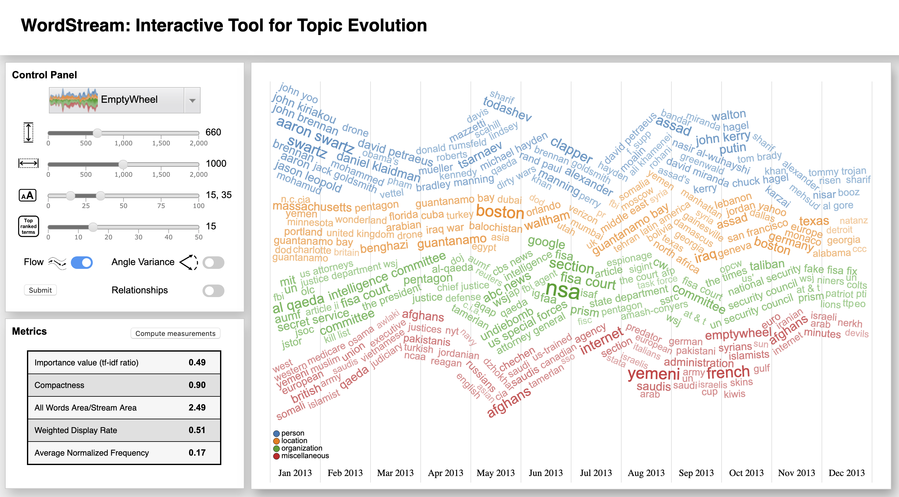
Architecture
Text sources
1. Preprocessing
Data
2. Building boxes
Update
Boxes
3. Placing terms
Layers
4. Drawing
Visualization
Evaluation
Notes:
We provide control panel and a group of metrics to evaluate and update the presentation

Slide 11
Architecture
Text sources
Customization
Width
Height
Orientation
Flow
Angle Variance
Font size
Top words
1. Preprocessing
Data
2. Building boxes
Update
Boxes
3. Placing terms
Layers
4. Drawing
Visualization
Evaluation
Notes:
We provide control panel and a group of metrics to evaluate and update the presentation

Slide 12
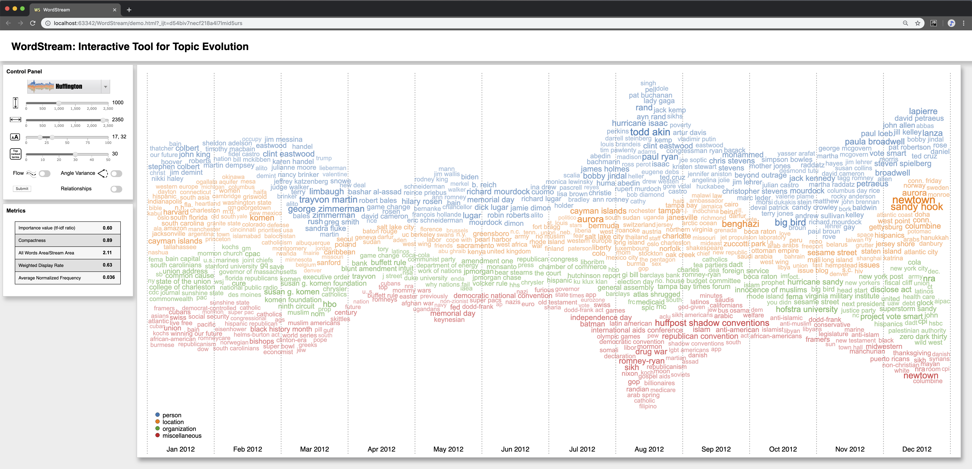
Case Study
Notes:
In Mar 2012, users can quickly see the names such as Trayvon Martin - George Zimmerman (person) and Sanford (location), regarding the Trayvon Martin shooting by George Zimmerman. The event happened in Sanford in late February 2012, but the investigation and news appear in the next month, March.

Slide 13
Case Study
Notes:
In August 2012, some remarkable terms are Todd Akin and Paul Ryan (person), with Romney-Ryan (other). Romney-Ryan is Mitt Romney and Paul Ryan, the 2012 Republican presidential ticket. Todd Akin is a representative who had controversial statement during the Senate race, and Paul Ryan is a co-sponsored with him on the bill.

Slide 14
Case Study
Notes:
In December 2012, Sandy Hook, Newtown, Lanza and NRA are the emphasized terms. This relates to Sandy Hook Elementary School shooting in Newtown, Connecticut by the shooter Adam Lanza. The shooting caused many questions of gun control legislation to NRA (National Rifle Association).

Slide 15

Quantitative Evaluation
None
Flow
Angle variance
Flow + Angle variance
2007 | 2008 | 2009 | 2010 | 2011 | 2012 | 2013 | 2014 | 2015 | 2016

Slide 16
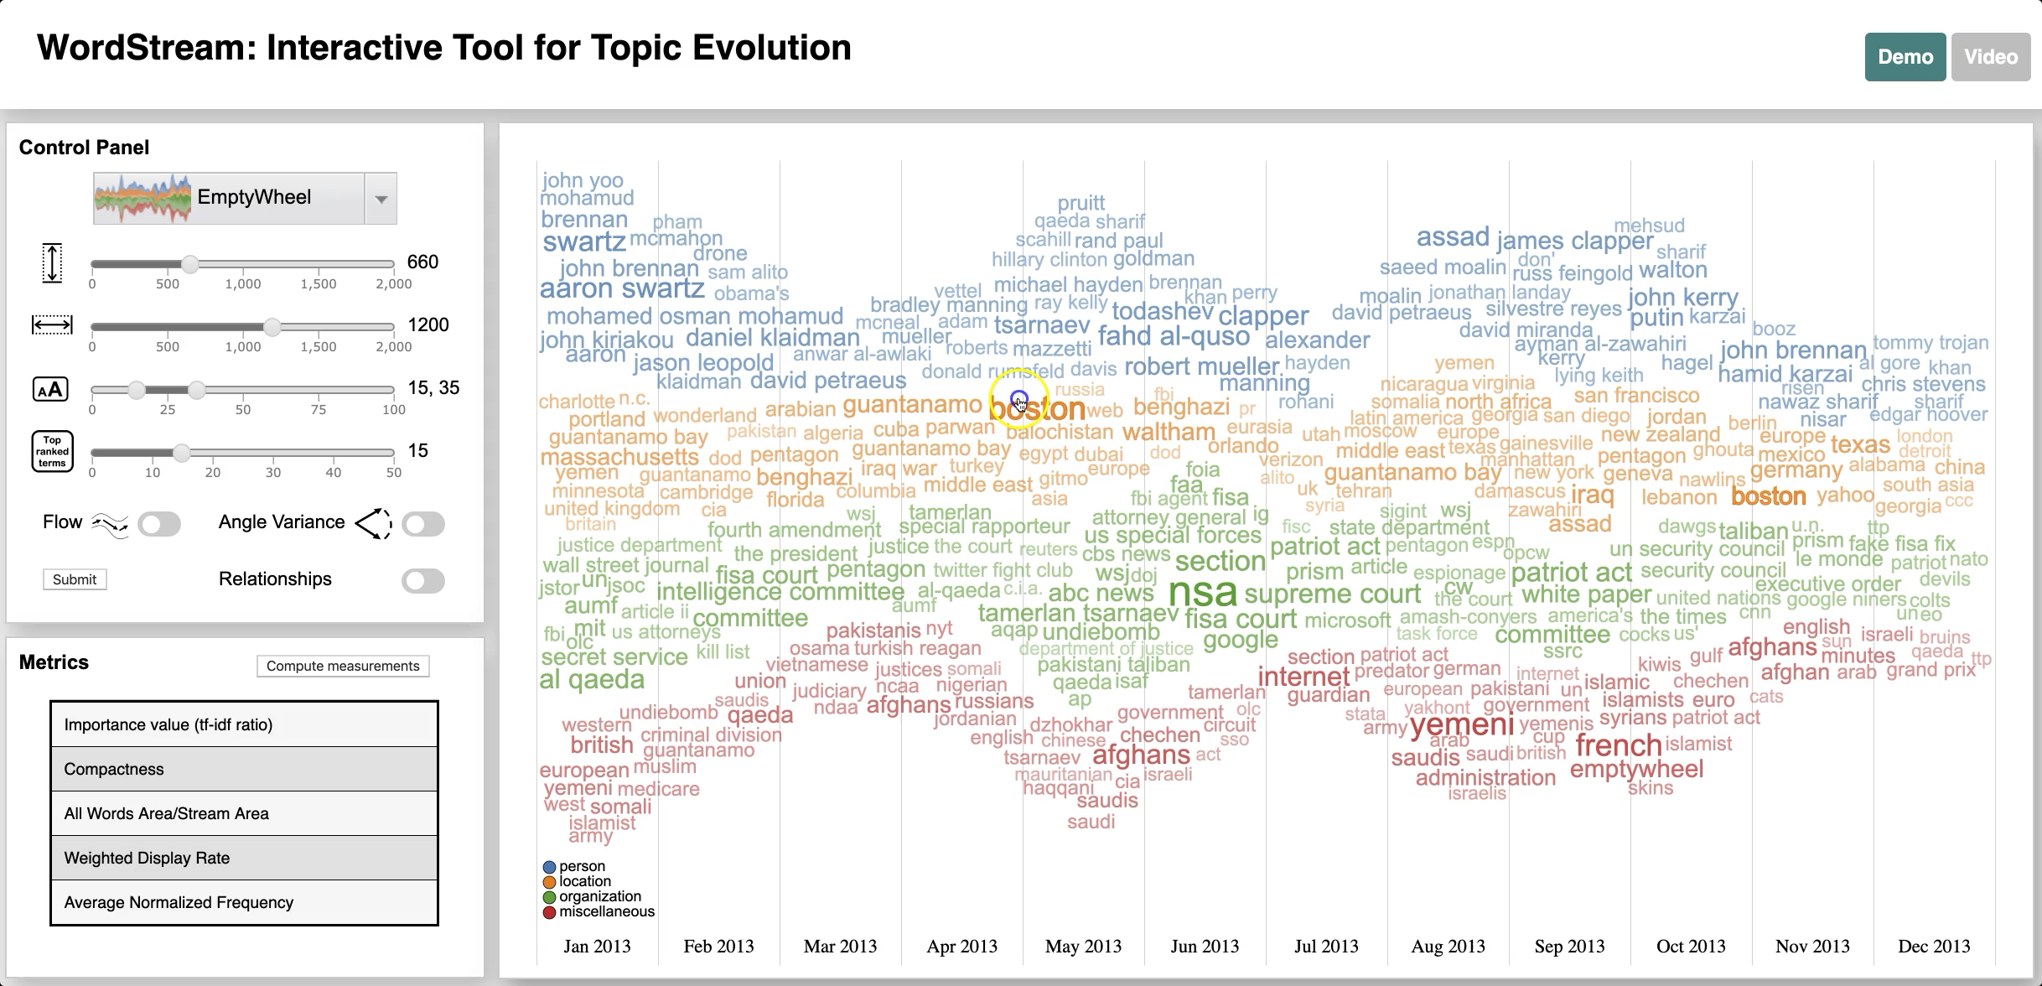
WordStreamVis.github.io
Video Demonstration

Slide 17
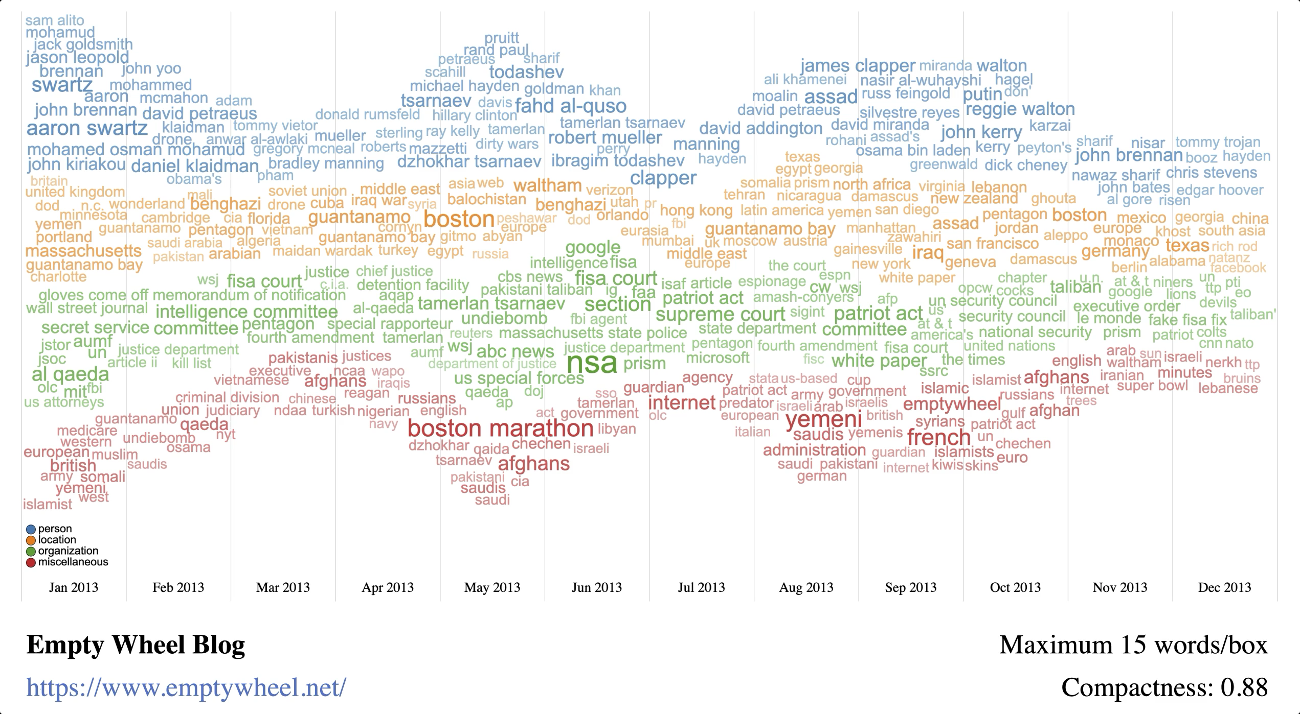
Thank you for listening!
Q&A

